Slide 1

Dry Beans Classification
Group 14
AJAY ATHITYA RAMANATHAN
RIDDHI GUPTA
HIMANI THAKKER
MONIL RAWKA

Slide 2
Introduction
The dry bean, the most widely grown edible legume crop in the world, has a wide variety of genetic variability. There is no doubt that seed quality affects crop production. In order to supply the fundamentals of sustainable agricultural systems, seed classification is crucial for both marketing and production. More than 13,000 samples of dry beans from 7 different species were photographed, and using computer vision techniques, their geometry was determined. We will be using this output dataset generated by the computer vision algorithm. This project’s main goal is to offer a process for obtaining consistent seed varieties from population-based crop production, which prevents the seeds from being verified as belonging to a single variety.

Slide 3
Dataset Description
1. Area (A): The area of a bean zone and the number of pixels within its boundaries.
2. Perimeter (P): Bean circumference is defined as the length of its border.
3. Major axis length (L): The distance between the ends of the longest line that can be drawn from a bean.
4. Minor axis length (l): The longest line that can be drawn from the bean while standing perpendicular to the main axis.
5. Aspect ratio (K): Defines the relationship between L and l.
6. Eccentricity (Ec): Eccentricity of the ellipse having the same moments as the region.
7. Convex area (C): Number of pixels in the smallest convex polygon that can contain the area of a bean seed.
8. Equivalent diameter (Ed): The diameter of a circle having the same area as a bean seed area.
9. Extent (Ex): The ratio of the pixels in the bounding box to the bean area.
10.Solidity (S): Also known as convexity. The ratio of the pixels in the convex shell to those found in beans.
11.Roundness (R): Calculated with the following formula: (4piA)/(P^2)
12.Compactness (CO): Measures the roundness of an object: Ed/L
13.ShapeFactor1 (SF1)
14.ShapeFactor2 (SF2)
15.ShapeFactor3 (SF3)
16.ShapeFactor4 (SF4)
17.Class (Y): Seker, Barbunya, Bombay, Cali, Dermosan, Horoz and Sira.

Slide 4
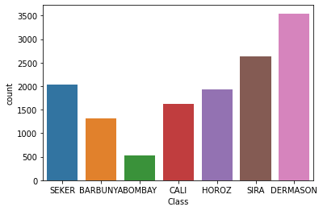
EDA
Target Variable Distribution
According to the graph above, there are different counts for each class. With 3546 beans, Dermason is the most prevalent class. Bombay has 522 beans, making it the least common class. Two classes have a significant distinction that should be considered while developing a model.

Slide 5
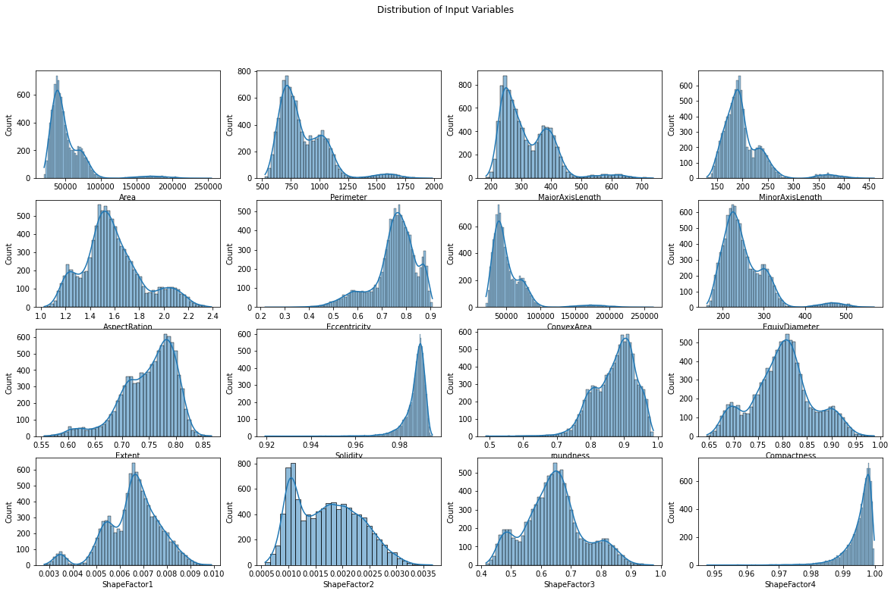
Input Variables Distribution

Slide 6
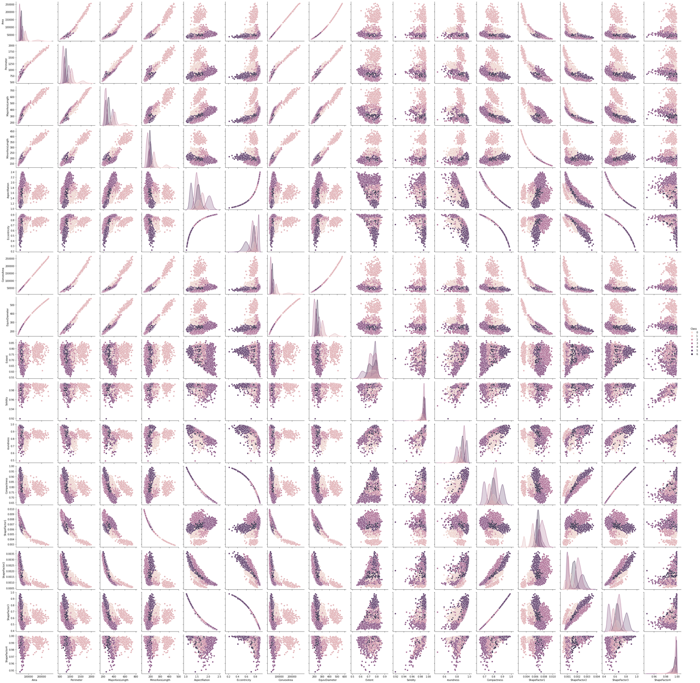
Pair plot
The pair plot shows us how the data is linearly separable when plotted against different dimensions

Slide 7
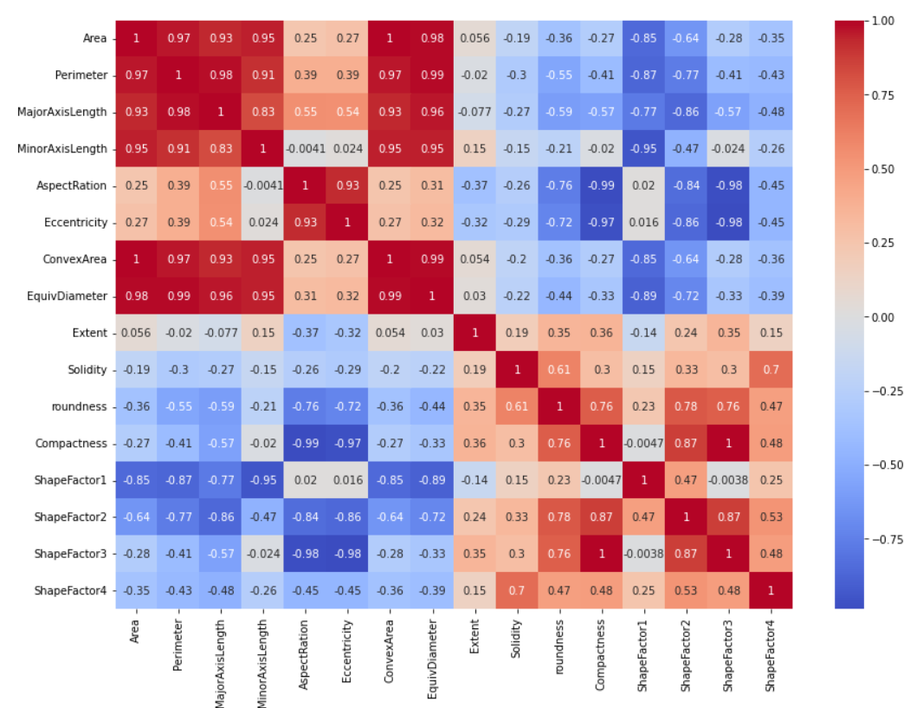
Correlation map of Input Variables
It's intriguing to see that certain characteristics show a high (linear) correlation with one another. For instance, among "compactness" and "shape factor 3," and between "convex area" and "area." This is expected given how closely connected the "area" and the "convex area" are. Although the calculation of "shape factor 3" and the other "shape factors" is not entirely obvious, it is reasonable to believe that the "compactness" of the beans had some sort of effect.

Slide 8
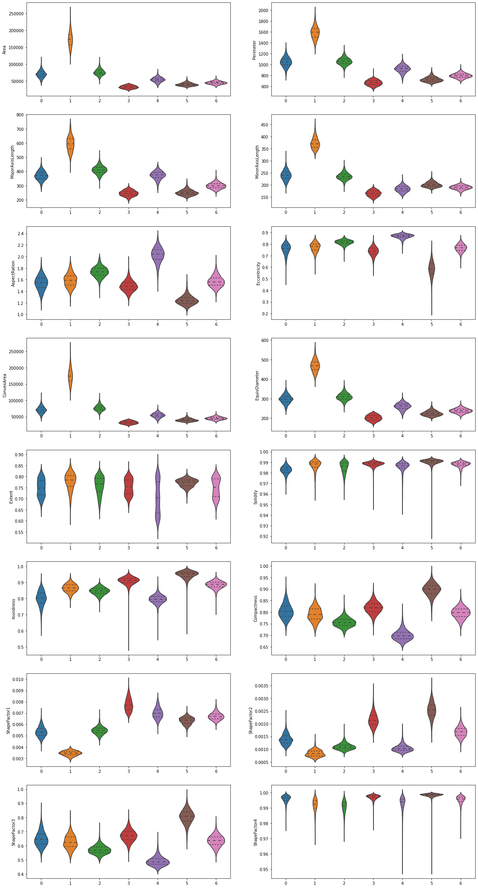
Violin Plot of Input Variables by class

Slide 9
Data Preprocessing
Standardization: A scaling technique where the values are centered around the mean with a unit standard deviation. This means that the mean of the attribute becomes zero and the resultant distribution has a unit standard deviation.
Label Encoding: The target variable ‘class’ is encoded using label encoder. The names are converted to class numbers from 0 to 6 representing 7 classes
Test Train Split: The dataset is split into 3 parts train, test, and valid with size 70%, 15%, 15% respectively.

Slide 10
PCA
Principal component analysis (PCA) is a technique that transforms high-dimensions data into lower-dimensions while retaining as much information as possible.
Principal component analysis proceeds in this fashion, with each new component accounting for progressively smaller and smaller amounts of variance (this is why only the first few components are usually retained and interpreted).

Slide 11
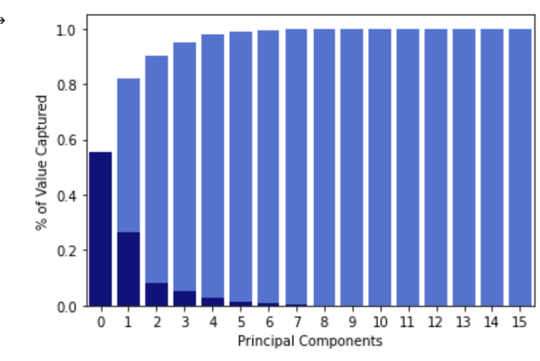
PCA
This is accomplished by producing fresh, uncorrelated variables that maximize variance one after the other. The components are created as linear mixtures or combinations of the basic variables, acting as new variables. The top four components account for more than 95% of the variance in the dataset, according to the principal component analysis shown below. Nearly all the volatility in the data can be explained by the first four components.
Explained Variance Captured
PC0 – 55%
PC1 – 26%
PC2 – 8%
PC3 – 5%

Slide 12
Final Dataset Variations
Skipped Steps
No outlier removal
No Feature dropped in Baseline
dataset
Baseline Dataset
No PCA, Standardized, No Columns Dropped
PCA Dataset
First 4 Principal components (95% explained variance)

Slide 13
Models
Following are the different Machine Learning Models we Implemented For Classification:
1. Logistic regression
2. Neural Networks
3. Gaussian Naïve Bayes

Slide 14
Logistic Regression
It's a form of statistical software that analyses the association between a dependent variable and one or more independent variables by estimating probabilities using a logistic regression equation.
This analysis can help anticipate the likelihood of an event or a choice occurring. The output obtained in the case of logistic regression is always between (0 and 1), which is suitable for a binary classification task.
The higher the value, the higher the probability that the current sample is classified as class= 1, and vice versa. It takes both continuous and discrete variables as input. The data fed into the model is upscaled on the minority class.

Slide 15
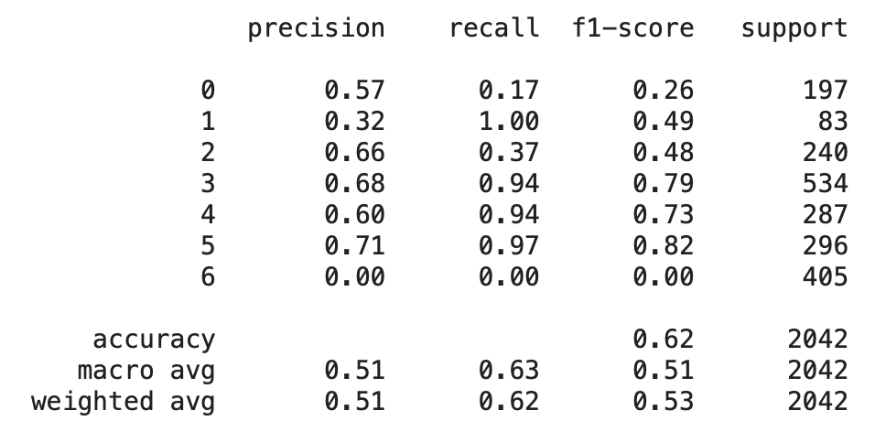
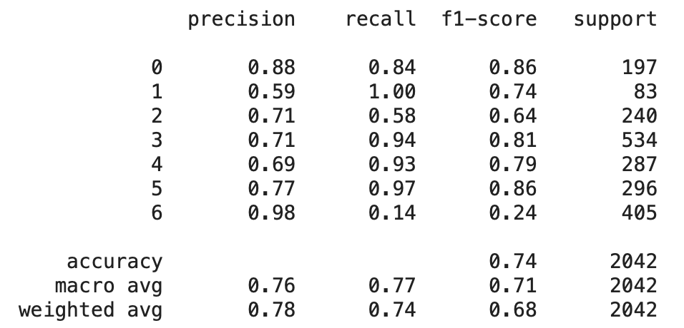
Results
7 Binary Classifiers.
In case of multiple classes having output 1, the class
with highest probability is chosen
With PCA
Train Accuracy: 62.98%
Test Accuracy: 61.9%
Without PCA
Train Accuracy: 73.2%
Test Accuracy: 73.51%

Slide 16
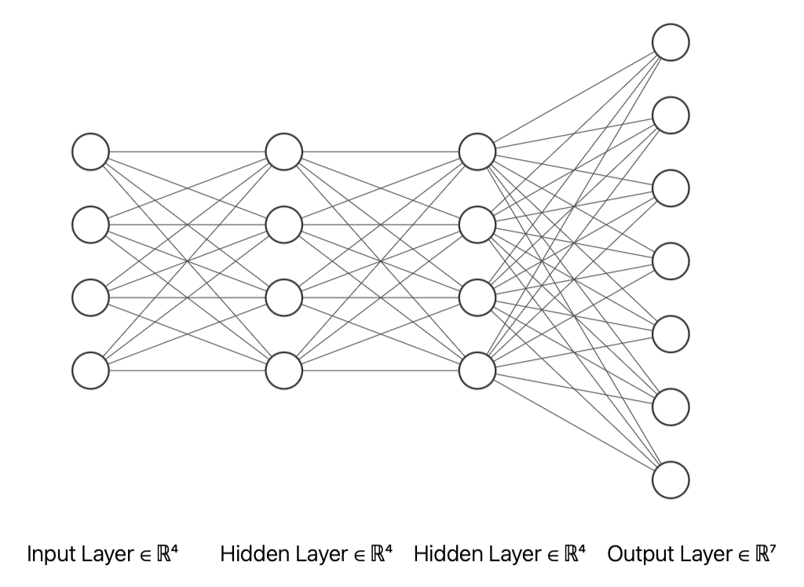
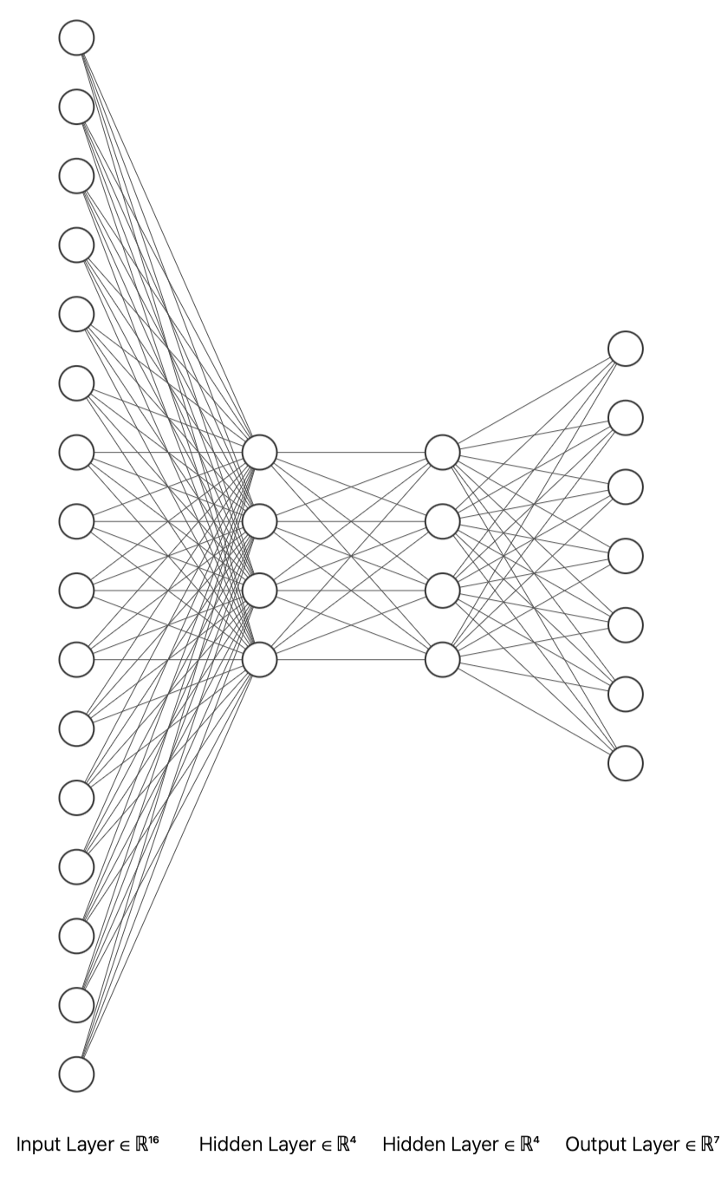
Neural Network
A neural network is a series of algorithms that endeavors to recognize underlying relationships in a set of data through a process that mimics the way the human brain operates.
Here, we have used fully connected neural networks with 1 input layer, 2 hidden layers, and a final output layer when the softmax function is applied to give the target variable.

Slide 17
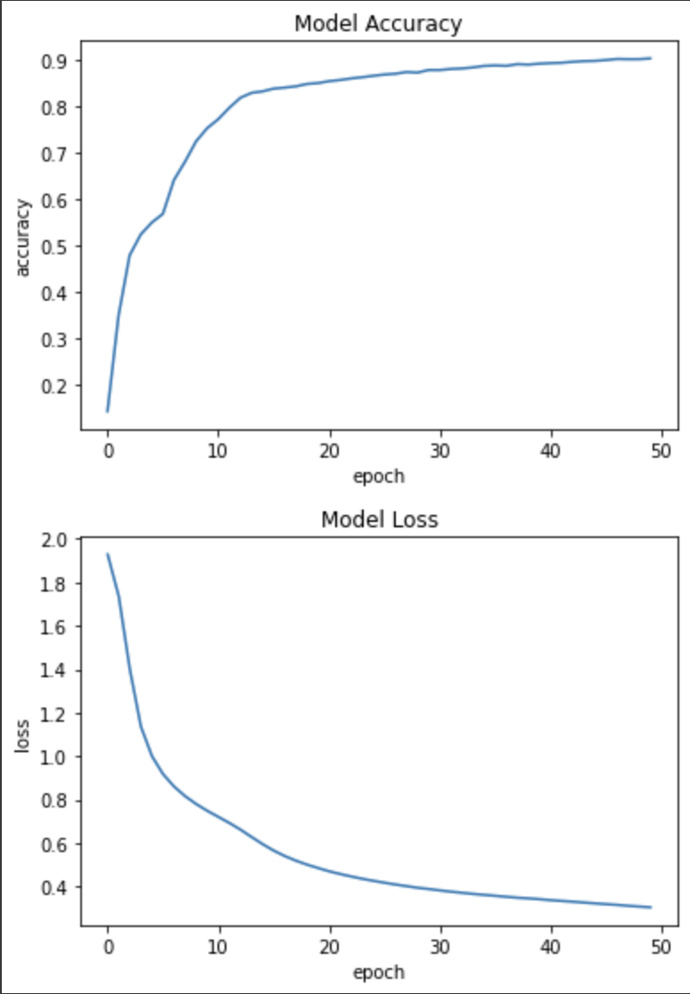
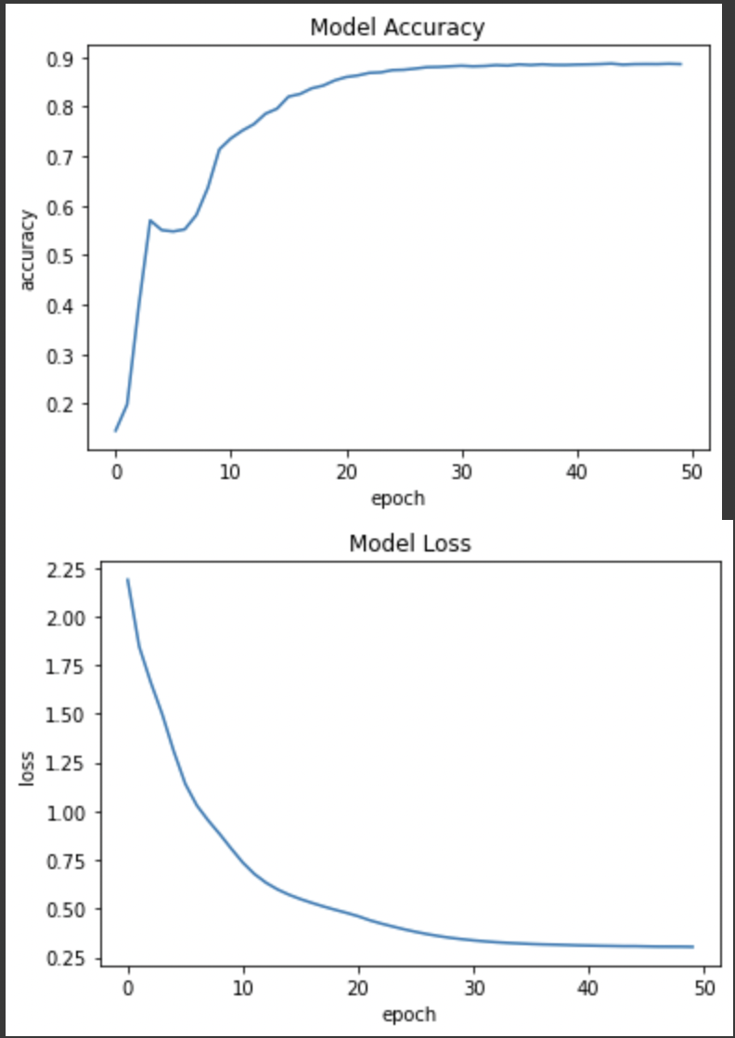
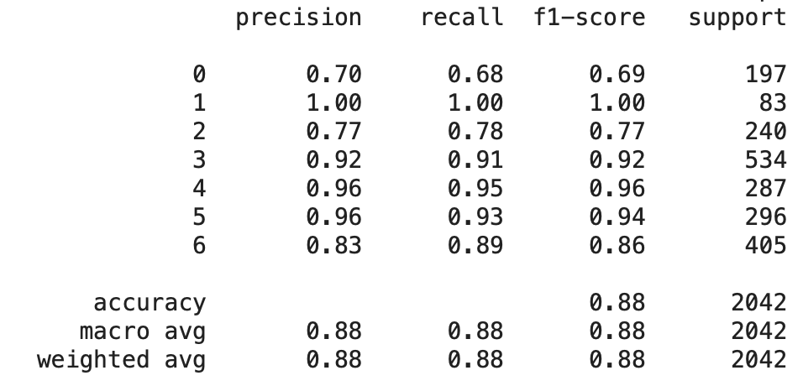
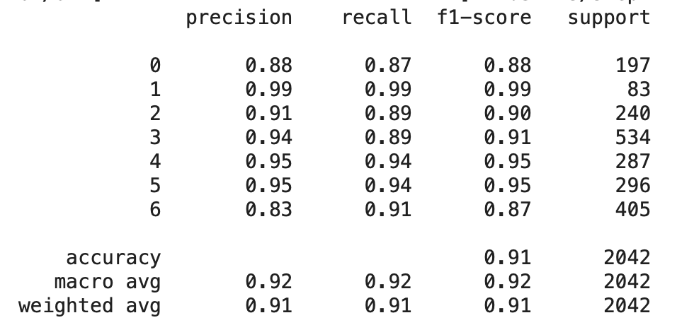
Results
2 Hidden Layers with 4 nodes each.
Trained for 50 epochs
With PCA
Train Accuracy: 88.91%
Test Accuracy: 88.0%
Without PCA
Train Accuracy: 91.2%
Test Accuracy: 91.51%

Slide 18
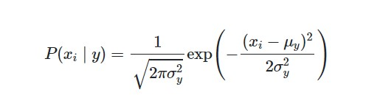
Gaussian Naïve Bayes
When working with continuous data, an assumption often taken is that the continuous values associated with each class are distributed according to a normal (or Gaussian) distribution. The likelihood of the features is assumed to be

Slide 19
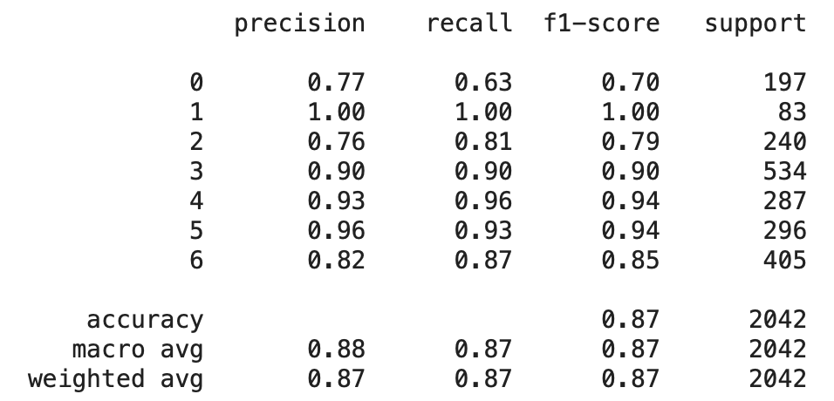
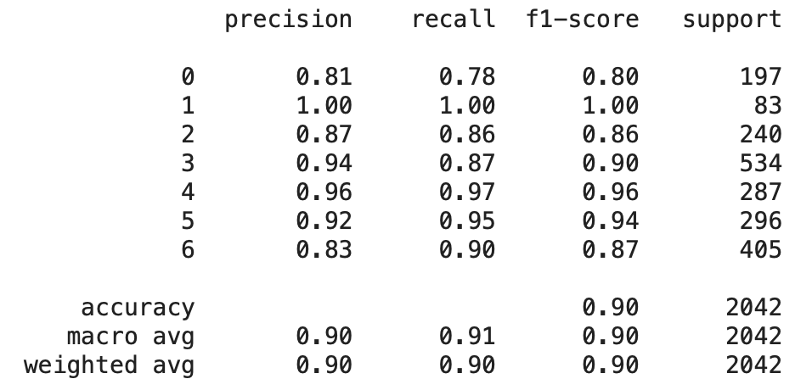
Results
With PCA
Train Accuracy: 86.23%
Test Accuracy: 87.27%
Without PCA
Train Accuracy: 89.55%
Test Accuracy: 89.81%

Slide 20
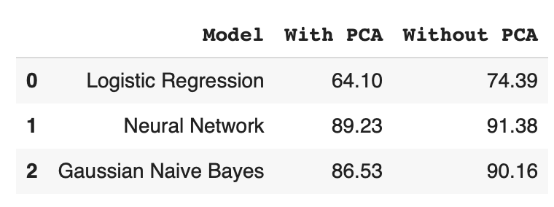
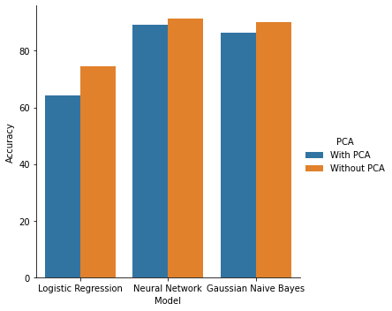
Model Selection
Neural Network model with standardized dataset (without PCA) has the best accuracy, f1 score, precision, and recall. The possible reasons behind it are:
PCA doesn’t takes into account the target variable in consideration and might drop features that are important that accounts for the drop of 2-10% in accuracy across all models.
Imbalanced dataset might be the reason behind low f1-score, and precision scores.
Even though our dataset is mostly distributed normally, few features had minute bi model bells

Slide 21
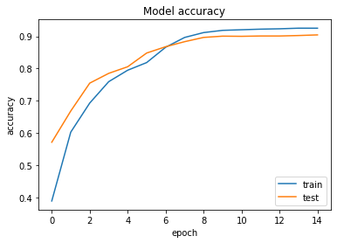
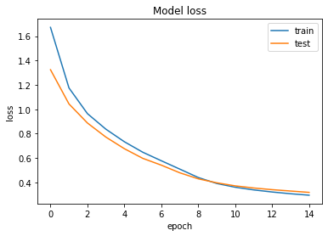
Model Tuning
Retrained the model with
Balanced Dataset by Oversampling using SMOTE
Reduced number of epochs from 50 to 15.

Slide 22
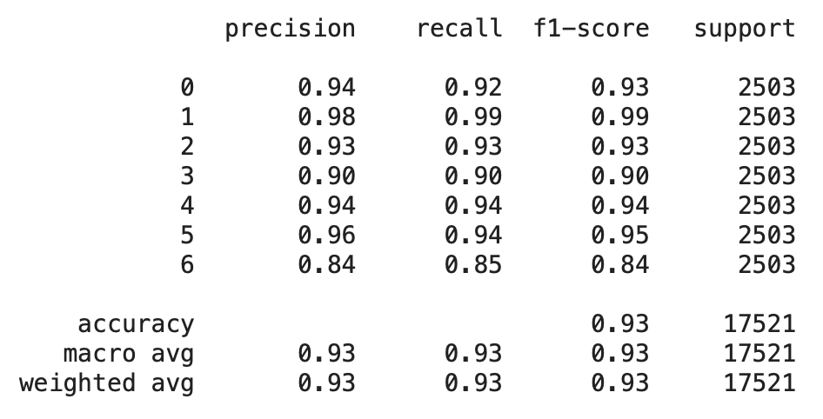
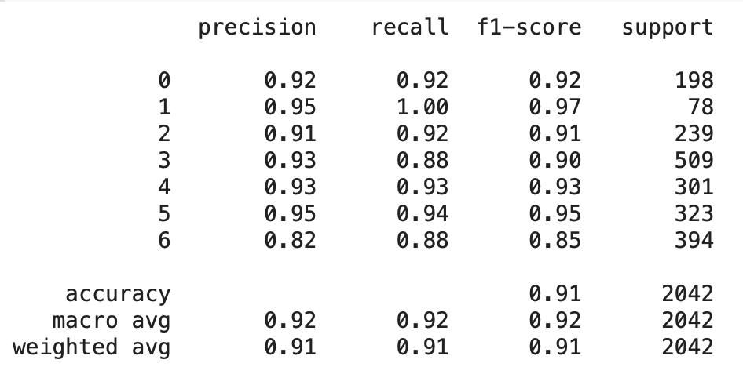
Metrics of Retrained Model
Training
Validation Set

Slide 23
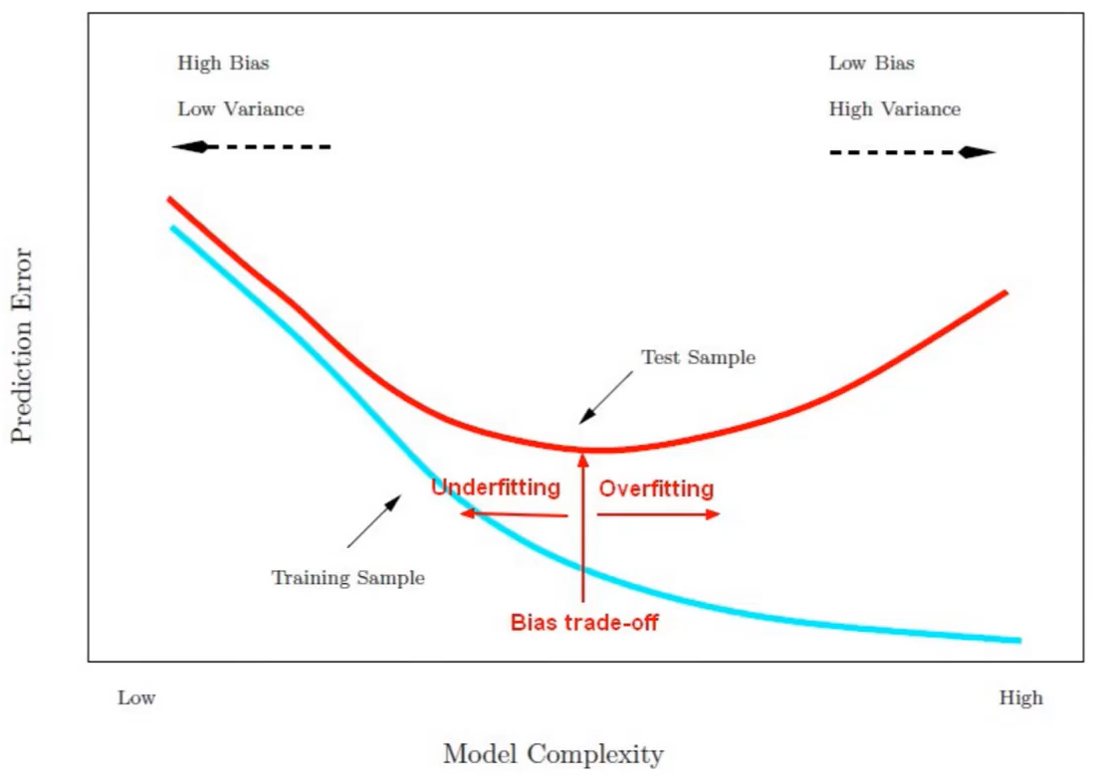
Fit of Model
(Using Zero-One Loss)
Train Error = 7.3%
Val Error = 9.2%
Note: Ref graph, not generated from the model

